Slide 1

Machine learning for NLP
Massimo Piccardi
University of Technology Sydney, Australia
32931 TRM, Natural Language Processing module

Slide 2
Agenda
Machine learning: main data types and problems
Choosing, training and testing a model
Main data types in NLP
Performance evaluation in NLP
Deep learning
Reinforcement learning
Notes:
Definition
Overview
More in-depth view
Tutorial

Slide 3
The AI “revolution”
Every day we hear about the surge of AI (i.e., artificial intelligence) in technology and society
While there is a certain amount of hype, it is impossible to deny its impact
“AI” coalesces building blocks such as machine learning and pattern recognition, computer vision, natural language processing, speech processing and various others
AI is growing jointly with computing and communication capabilities; i.e., GPUs, cloud and edge computing etc

Slide 4
A bit of glossary
Machine learning is the ability of a machine to learn from data
Pattern recognition is the ability to automatically recognise patterns in data and is a (substantial) part of machine learning
Data science (and also data mining, data analytics) is the “organizational counterpart” of machine learning and emphasises implementation, scalability and workflow

Slide 5
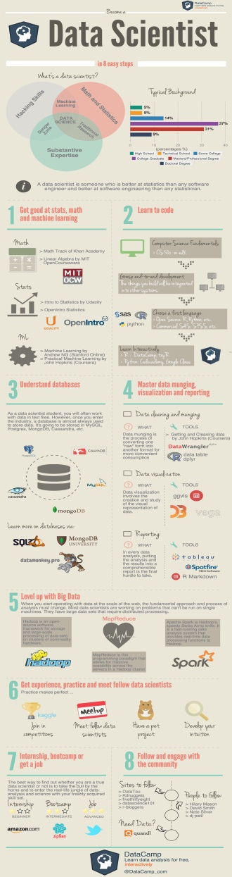
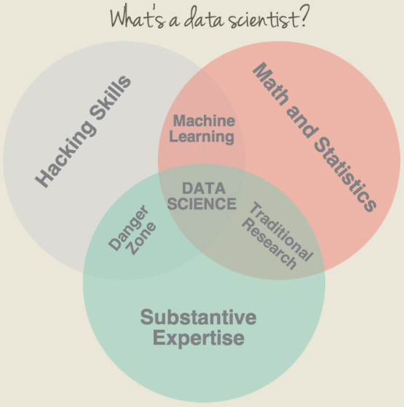
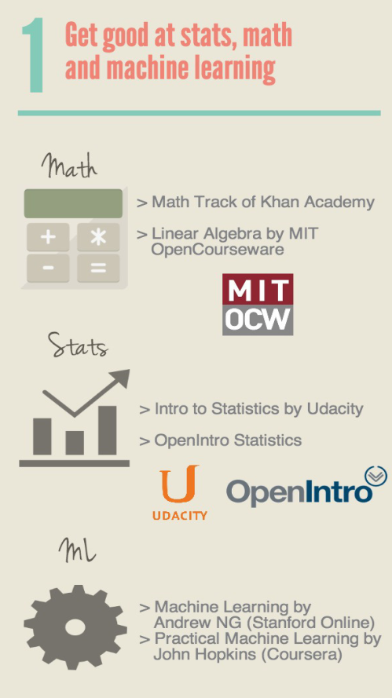
Data science: a useful infographic
from the DataCamp’s team

Slide 6
Types of data
Data can be of greatly different nature, but they boil down to two fundamental types:
numerical: quantities that can be summed, divided, averaged, compared etc
examples: age, income, speed, area
categorical: data that represent “categories” or symbolic values
examples: professions, car models, words
Often, you combine them into arrays (e.g. {age, income, profession})
Notes:
You cannot add up two cars and obtain their average

Slide 7
Machine learning: fundamental problems
In a nutshell, machine learning can be defined as a way to predict the value of a numerical or categorical variable based on a bunch of other numerical and/or categorical data
The fundamental problems are known as:
classification: predict a categorical value from an array of numerical/categorical
regression: predict a numerical value from an array of numerical/categorical
clustering: group numerical data “homogenously”

Slide 8
Classification
measurement
classifier
class
The class takes categorical values; e.g., “Netflix subscriber”
The measurement can be multiple (e.g., age, income, occupation), and both numerical and categorical

Slide 9
Regression
measurement
regressor
response
The response takes numerical values; e.g., “holiday expenses”
The measurement can, again, be multiple (e.g., age, income, occupation), and both numerical and categorical

Slide 10
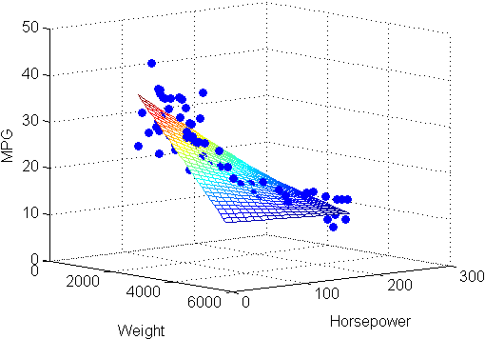
Example
Predict a car’s mileage per gallon from weight and horsepower (source: the MathWorks)

Slide 11
Clustering
clustering algorithm
cluster index
measurement
The cluster index is akin to a categorical value; e.g., “cluster 3”, “cluster B”. It just doesn’t have a meaning a priori
The measurement is typically multiple and numerical

Slide 12
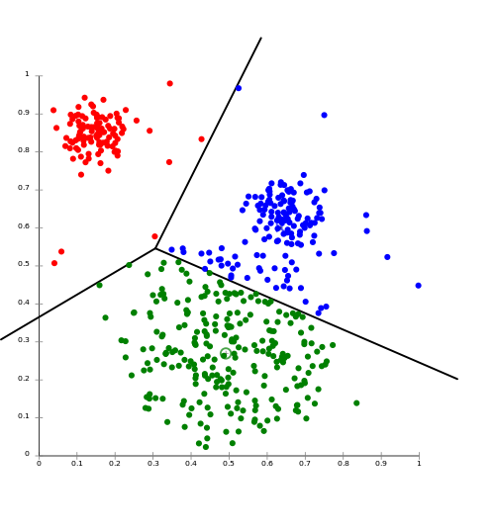
Example
source: Wikimedia Commons
12

Slide 13
Choosing, training and testing a model
Given a problem and a data set, you will have to choose a model for the prediction
This choice is often based on a model’s “reputation”, your experience, and/or an empirical comparison amongst a pool of plausible models
Every model contains a set of adjustable parameters; you train them using (a part of) the data set
Then you can test the accuracy of your trained model using the (rest of your) data set, and, if ok, use it!

Slide 14
Choosing, training and testing a model
For classification and regression, you will need a supervised aka annotated dataset of pairs:
(measurement, true/desired output)
Such a dataset is needed for both training of the model and evaluation of its accuracy
For clustering, you typically need only an unsupervised/unannotated dataset of measurements
Evaluation is conducted using only intrinsic measures such as cluster separation and compactness

Slide 15
Classification: popular algorithms
Basic: Bayesian classifier and logistic regression classifier
Deep neural networks (FFNNs, CNNs etc)
XGBoost
Support vector machine (SVM)
k nearest neighbours (kNN)
Decision trees and random forests

Slide 16
Regression and clustering: popular algorithms
Regression:
Linear regression
Ridge and lasso regression
Gaussian processes
Clustering:
k-means
PAM and all other female-named clustering algorithms such as AGNES, DIANA, DAISY etc

Slide 17
Main data types in NLP
The main data types in NLP are words, sentences and documents
Words:
Words are, intrinsically, categorical values in a vocabulary of, say, size V (from index 0 to index V-1)
When used as inputs, each word is usually converted to an embedding (typically, a 50-1024D vector)
Words are also string of characters, and lexical and morphological aspects can be leveraged (e.g., albuterol, stylish, predetermined…)

Slide 18
Main data types in NLP
Sentences:
Sentences/paragraphs are often treated just as the explicit sequence of their composing words. They also now have their own embeddings (Google’s Universal Sentence Encoder)
Documents:
Documents are often converted to vectors:
term frequencies (aka “bag of words”)
tf-idf
doc2vec
topic models

Slide 19
Performance evaluation in NLP
Performance evaluation is tricky for many NLP tasks since there is no easily agreeable “ground truth” aka “gold standard”
Proper performance evaluation is the subject of much community discussion and even a research topic in its own right
Understanding NLP performance evaluation and performance metrics is very important to make informed technical and business decisions

Slide 20
Example: named-entity recognition (NER)
false positive (incorrect boundaries)
NB: named entities are multi-words spans!
“The Royal Bank of Scotland has around 700 branches, mainly in Scotland, though there are branches in many larger towns and cities throughout England and Wales. Both the bank and its parent, The Royal Bank of Scotland Group, are completely separate from the fellow Edinburgh-based bank, the Bank of Scotland, which pre-dates The Royal Bank of Scotland by 32 years.”
true positive
missed a chance to score a true positive

Slide 21
Example: machine translation
The NER case is relatively easy, since different human annotators often agree about the true labels
Much more challenging cases are machine translation, summarisation and question answering, where multiple ground truths can be equivalently desirable (and also, how bad are the errors?)
In machine translation, the dominant metric is the BLEU score that is based on matching n-grams, but others based on comparing word embeddings have emerged (e.g., BERTScore, MoverScore)

Slide 22
Trending approaches in machine learning
Approaches in machine learning have remarkably evolved over time
At present, the greatest focus is on deep learning and reinforcement learning
Deep learning is a mature technology that is almost universally employed wherever there are sufficient data for training
Reinforcement learning is more a technology for the future, but it’s starting to gain significant application

Slide 23
Deep learning
Deep learning refers to artificial neural networks (ANNs) with many layers and complex architecture
ANNs had been very popular in all the 1990’s, but had almost been “abandoned” in favour of SVM
From circa 2006, neural networks with more complex architecture have had an extraordinary uptake
They are now dominating the application scene (NLP, computer vision, speech and much more)

Slide 24
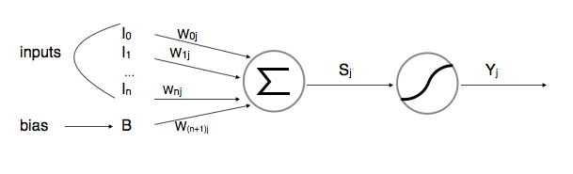
Typical layer
A typical layer of a neural network is equivalent to a simple classifier/logistic regressor:
The inputs are multiplied by a set of weights (the parameters) and added up; the sum goes through a nonlinear function (called a sigmoid)
from Jed Fox, Neural Networks 101

Slide 25
Basic overall scheme
output y
classification
(0,1)
regression
(-∞,+∞)
sigmoid
weighted sum (w_{N})
…
sigmoid
weighted sum (w₁)
input x ∈ ℝ^{D}

Slide 26
Development
A wealth of libraries is available for development: Caffe, CNTK, Keras, Torch, TensorFlow, MXNet/Gluon…
Mostly Python-based, but also Matlab
Two tools likely the most popular at present:
PyTorch (the PyTorch Team; primarily developed at Facebook AI Research lab (FAIR))
TensorFlow 2.0 (Google Brain team; a step change wrt to 1.X with features now similar to PyTorch)
They all use autodiff: can train a model automatically!!!

Slide 27
Most popular deep networks for classification
Some deep networks have become the workhorses of classification tasks:
Feed-forward neural networks
Convolutional neural networks (CNNs)
Recurrent neural networks (RNNs) such as LSTMs and transformers – to classify sequential data (such as text, speech, video, time series)
But the architectures used for NLP are often more complex, modularly combining many basic blocks

Slide 28
Machine learning & NLP: main cases
Many NLP tasks fall within a few ML cases:
Each has nowadays some kind of “reference” deep learning architecture. A couple of examples follow
Input | Output | Tasks
sequence of words | class label | sentiment analysis, document classification etc
2 sequences of words | class label | similarity, paraphrase, contradiction, implication
sequence of words | sequence of words | translation, summarisation, Q&A etc
… | … | …

Slide 29
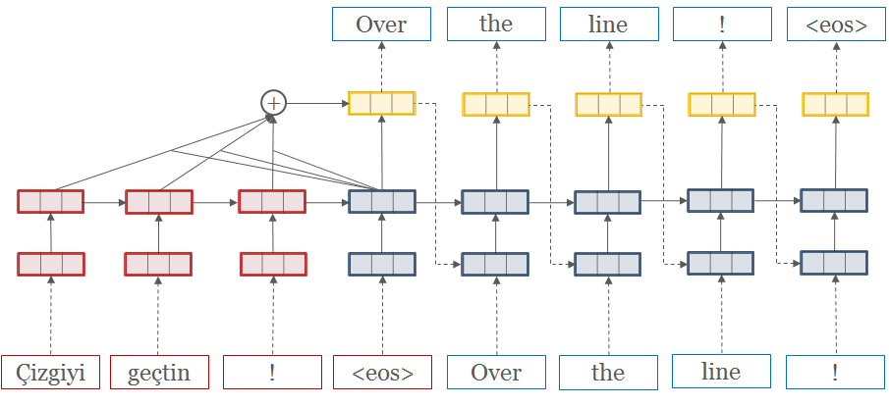
Seq2seq for machine translation
translated sentence
attention weights (generated by another sub-network)
context vectors
softmax layer
encoder
decoder
courtesy of Klein et al., arXiv 2017
source sentence
word embeddings

Slide 30
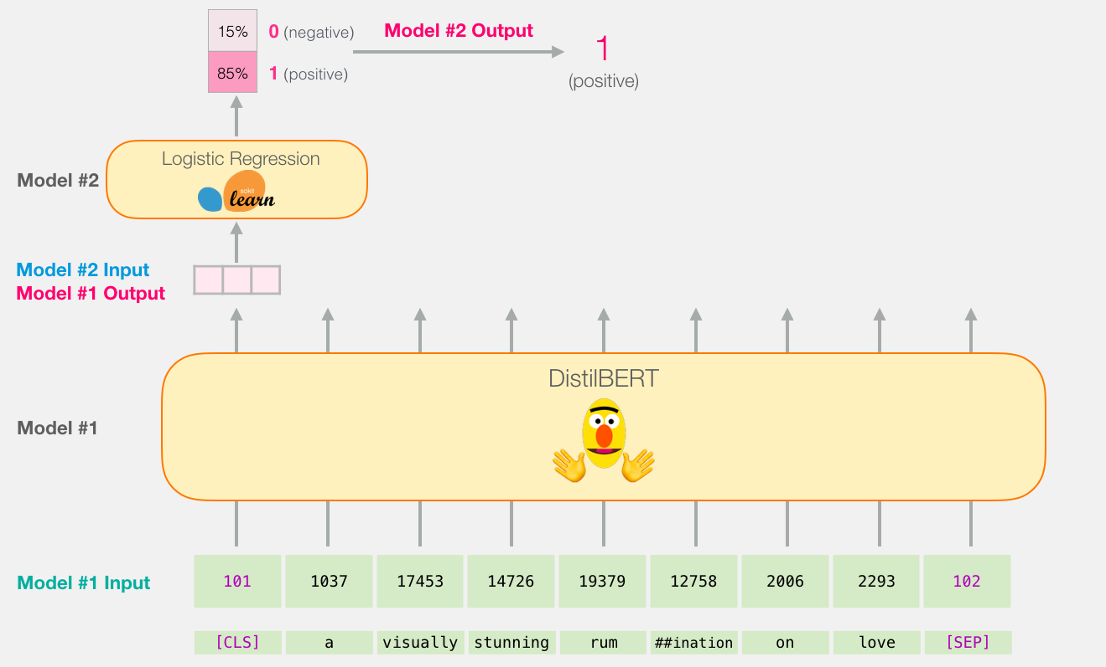
BERT
BERT is a very popular encoder that is used in a multitude of classification tasks
courtesy of Jay Alammar's exceptional blogs

Slide 31
GPT
GPT are a series of extraordinary language models released by OpenAI
GPT-2 gained world-wide attention when it generated highly realistic stories that had no significant overlap with its training set
"The scientist named the population, after their distinctive horn, Ovid’s Unicorn. These four-horned, silver-white unicorns were previously unknown to science.
Now, after almost two centuries, the mystery of what sparked this odd phenomenon is finally solved.
…"
GPT-3 has 175 billion trainable parameters; for comparison, the human brain has on average 86 billion neurons
Jan 2021: Google's Switch Transformer
has broken the trillion parameters threshold!
Notes:
OpenAI has deemed GPT-2 to be too dangerous to be released in full (automated fake news generation at unprecedented scales)

Slide 32
Reinforcement learning
Reinforcement learning (RL) can be introduced by contrasting it to supervised learning:
In supervised learning, we are given a set of inputs and desired outputs, and a loss function. A model is learned by minimising the loss function over the training set
In reinforcement learning we tend to talk about final goals and rewards towards those goals
Classification is performed sequentially, and at every point in time the classifier is in a specific state

Slide 33
RL: schematic
The system moves to a certain state, and receives a local reward
The system reaches its final state
s₁
…
s_{t-1}
s_{t}
…
s_{T}
states
a₁
…
a_{t-1}
a_{t}
…
a_{T}
actions
The system decides what to do next

Slide 34
RL: success stories
Robotics: walking, grabbing, playing, sensing
Control: flying a helicopter
Operations research: pricing, delivering, marketing
Games: backgammon (1995), checkers (2001), solitaire (2005), Go (AlphaGo, 2015-2017)
NLP: learning to dialogue
Economics: learning to trade
Although not yet established as supervised learning, RL is reaching maturity

Slide 35
Some useful references
Christopher M. Bishop, Pattern recognition and machine learning, 5th Edition, Information science and statistics, Springer 2007, ISBN 9780387310732, pp. I-XX, 1-738
Daniel Cer, Yinfei Yang, Sheng-yi Kong, Nan Hua, Nicole Limtiaco, Rhomni St. John, Noah Constant, Mario Guajardo-Cespedes, Steve Yuan, Chris Tar, Yun-Hsuan Sung, Brian Strope, Ray Kurzweil, Universal Sentence Encoder. CoRR abs/1803.11175 (2018)
Quoc V. Le, Tomas Mikolov, Distributed Representations of Sentences and Documents, ICML 2014: 1188-1196 (doc2vec)
Kishore Papineni, Salim Roukos, Todd Ward, Wei-Jing Zhu, Bleu: a Method for Automatic Evaluation of Machine Translation, ACL 2002: 311-318
Guillaume Klein, Yoon Kim, Yuntian Deng, Jean Senellart, Alexander M. Rush: OpenNMT: Open-Source Toolkit for Neural Machine Translation. ACL (System Demonstrations) 2017: 67-72
Ian Goodfellow, Yoshua Bengio, Aaron Courville, The Deep Learning Book, MIT Press, 2016, http://www.deeplearningbook.org
Rich Sutton, Andrew Barto, Reinforcement Learning: An Introduction, MIT Press, 2018 edition
S. Singh, Successes of reinforcement learning, http://umichrl.pbworks.com/w/page/7597597/Successes%20of%20Reinforcement%20Learning

